Slide 1
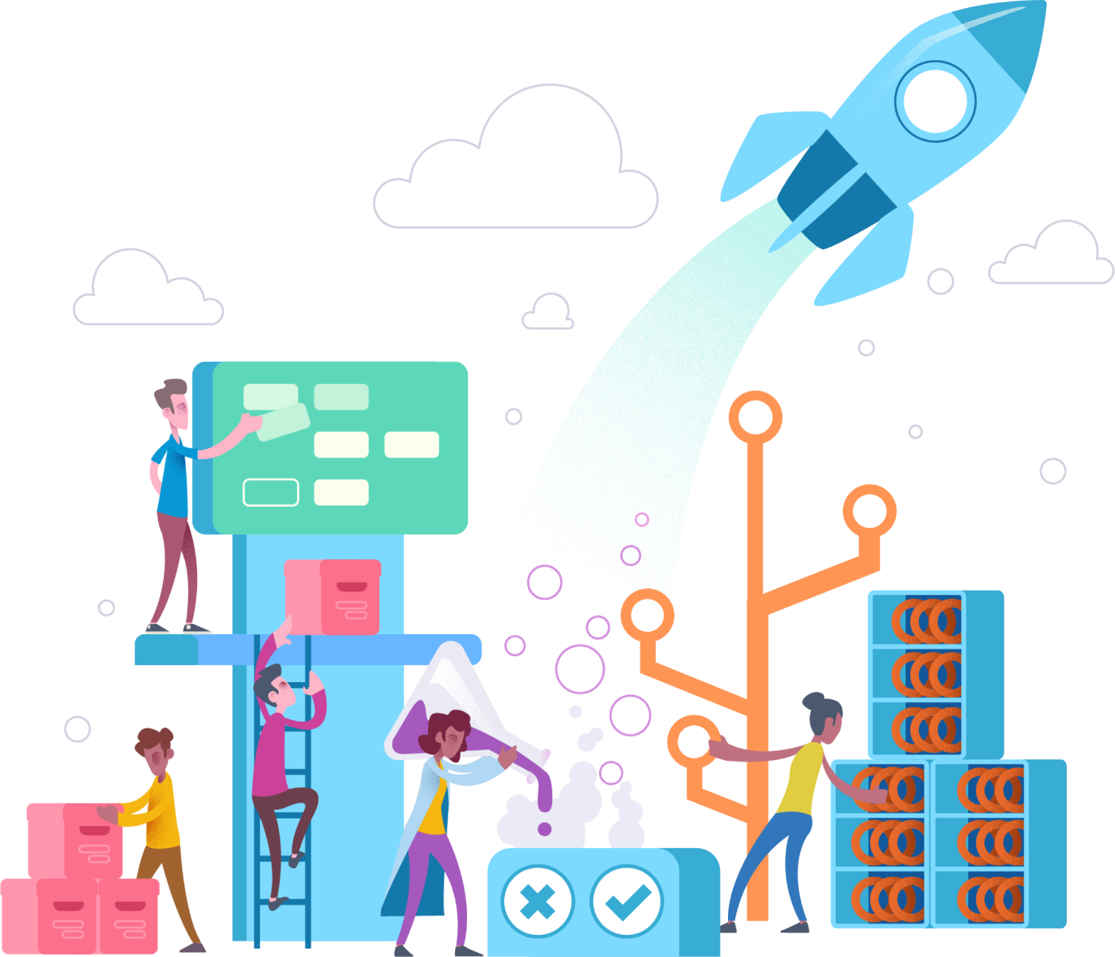
Microservices Overview
Notes:
SPEAKER NOTES:
This slide deck may support educating the customers about Microservices. The target audience are customer architects and their senior engineers (Level 300/400).
It is mostly cloud agnostic, but Microsoft Azure can help a lot managing all this moving pieces. Microservices itself are quiet useful during app modernization and cloud migration.
Mastering microservices requires a high degree of automation, so additional education in Azure DevOps might be a possible follow-up to this presentation.
Finally looking into container orchestrators like Azure Kubernetes Service, Service Fabric and Service Fabric Mesh will also be required for adopting microservices in an efficient manner.

Slide 2
N-Tier Architecture
Presentation
Benefits
Separation of concerns
Decomposition of code into functional components
Domain Logic
Data Storage
Challenges
Tight-coupling
Long development cycles
All or nothing scaling
Facade
Processing
I/O
Notes:
SPEAKER NOTES:
Multi-tier, N-tier monolithic architecture
A model by which developers can create flexible and reusable applications. By segregating an application into tiers, developers acquire the option of modifying or adding a specific layer, instead of reworking the entire application.
A three-tier architecture is typically composed of a presentation tier, a domain logic tier, and a data storage tier.
In web applications, the 3 tiers often correspond to:
Front-end serving content rendered in a browser
Application server serving the front-end and applying domain logic
A database tier as the single source of truth
Used technology like DCOM/.Net Remoting Java RMI/RPC
Benefits
Separation of concerns
Decomposition of code into functional components
Challenges:
Tight coupling: causes coding issues, making changes is difficult
Ever had to ramp up on a monolithic project? It takes time to understand and contribute, one false move and you can break the entire system
Code reuse/re-purposing – far too easy to pollute a components original intent in order to satisfy an immediate need
Unit testing small code-changes is not enough as it may impact other elements of the system; thus requiring complete regression testing for each deployment
Because it’s a monolith, the development cycle can be quite long, a small change requires a build and deployment of the entire solution
Scaling: you can horizontally scale, but you have to scale the app in its entirety
These challenges snowball as the application ages

Slide 3
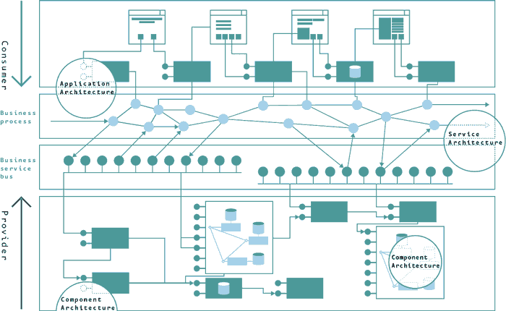
Service-Oriented Architecture
“The policies, practices, frameworks that enable application functionality to be provided and consumed as sets of services published at a granularity relevant to the service consumer.
Services can be invoked, published and discovered, and are abstracted away from the implementation using a single, standards-based form of interface.”
Services are discoverable and leverage components
Services are consumed by apps via “light-weight” service bus.
Services are orchestrated into business processes
apps
business processes
service bus
Challenges
Rise of ESBs
Centralized governance policies
Business services
components
Notes:
SPEAKER NOTES:
SOA
It’s all about the service. The is the important concept. Web Services are the set of protocols by which Services can be published, discovered and used in a technology neutral, standard form.
SOA is not just an architecture of services seen from a technology perspective, but the policies, practices, and frameworks by which we ensure the right services are provided and consumed.
The service bus is like the matrix. With SOA it is critical to implement processes that ensure that there are at least two different and separate processes—for provider and consumer. Rather than leaving developers to discover individual services and put them into context, the Business Service Bus is instead their starting point that guides them to a coherent set that has been assembled for their domain.
Benefits:
Services are discoverable and self-describing via Message and Operation Contracts
Strong contracts as a result of SOAP and WSDL
Ability to deploy services independently
Challenges:
Increased overhead
Complex service management
High investment cost – SOA requires big up front investment
The rise of heavy ESBs - performing message routing, transformations, logic operations, orchestrations – resulted in:
tight coupling between internal and external components
Became a barrier to adoption and ease of use
Centralized governance policies inhibited agility and creativity; you had to remain within strict bounds, you couldn’t simply use the right technology for the right job
Became cost-prohibitive; at times was easier to manage monolith than a SOA system

Slide 4
What are Microservices?
Definition
The microservice architectural style is an approach to developing a single application as a suite of small services, each running in its own process and communicating with lightweight mechanisms, often an HTTP resource API. These services are built around business capabilities and independently deployable by fully automated deployment machinery. There is a bare minimum of centralized management of these services, which may be written in different programming languages and use different data storage.
“
”
[James Lewis & Martin Fowler]
Notes:
SPEAKER NOTES:
There are many definitions for microservices, so we just picked the most prominent one by James Lewis and Martin Fowler.
Generally speaking microservices follow a rather holistic approach so they can evolve individually, basically by aligning business, services and team boundaries.
Since microservices are independent to each other with no need for central management, they can also be managed and scaled individually.
This especially helps you when scaling towards multiple distributed teams, which is one of the main use cases for microservices.

Slide 5
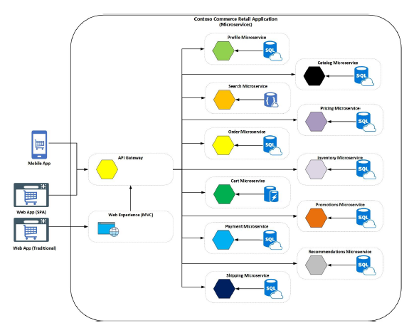
Microservices Are:
Services implement single business or technical concern (single responsibility principle)
Each service has its own data repository
Services are developed, deployed and scaled independently
Clients access the services through well-defined APIs or Messages
Services run in their own processes and/or containers
Notes:
SPEAKER NOTES:
This details the previous slides and highlights the microservices characteristics. This slides can be seen in contrast to the slide about monoliths.
While monoliths implement multiple business concerns, each microservices implement a single business or technical concern.
Also very important, each microservices has its own data repository, so they can be developed, deployed and scaled independently.
Finally highlight that you also require some infrastructure pieces like API Gateways and container orchestrators, which Azure can provide you out of the box.
The Single Responsibility Principle (SRP) states that each software module should have one and only one reason to change. ref: https://blog.cleancoder.com/uncle-bob/2014/05/08/SingleReponsibilityPrinciple.html. Generally this means that you strife to ensure that a given service performs a single distinct business function which allows for fixes, enhancements, etc… to be isolated.
The key message is that smaller and more isolated is better. Not only the sizes of the services, but also the sizes of changes. Small, iterative changes are easier to implement, and easier to rollback. “Aim small, miss small”

Slide 6
Benefits
Small, focused teams
Independent development
Mixed technology stacks
Independent deployments
Fault isolation
Granular scaling
Notes:
SPEAKER NOTES:
Microservices were vastly adopted, since they come also with a lot of benefits. They might enable other best practices i.e. doing DevOps with a large monolith might be quiet challenging.
Microservices are much smaller and independently deployable, so DevOps adoption is much easier. Better have many speed boats compared to a large tanker.
Also mixing technology stacks is quiet common these days, i.e. some AI/ML experts can write some custom machine learning and expose it as a microservice.
The consuming engineering teams do not have to know machine learning at all, they just consume the microservice via a convenient API.
That’s what Microsoft internally did for instance with the Cognitive Services, but also Azure DevOps is built on top of microservices.

Slide 7
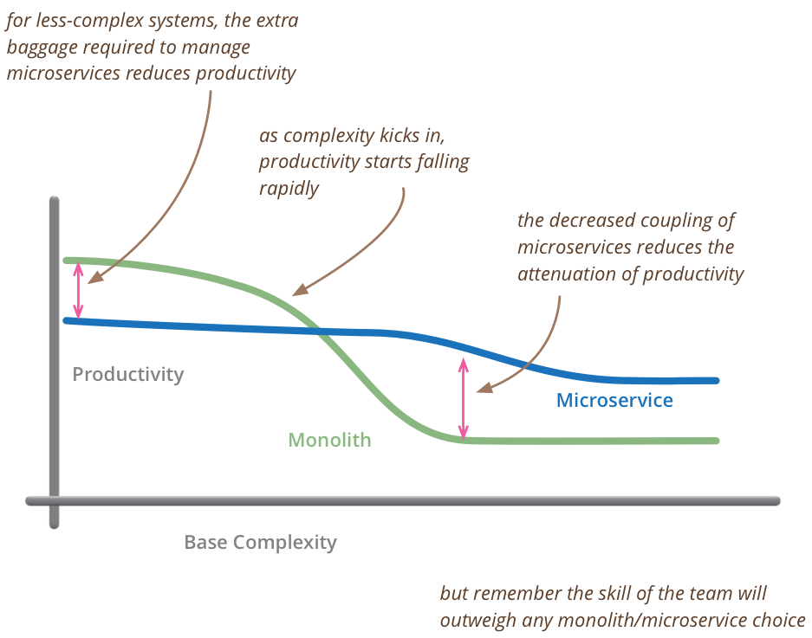
Challenges
Complexity
Service boundaries
Data consistency/integrity
Network congestion/latency
Client communication
DevOps
- Martin Fowler
Notes:
SPEAKER NOTES:
As we will see, microservices are no silver bullet. They come with a lot of operational complexity to master.
Basically there is a break even, when it is worth to use microservices over monoliths – see graph on the right.
When adopting microservices, the challenges listed must be individual addressed and we will talk about them in a minute.
That’s why Azure is a great choice for hosting microservices, considering most of the required capabilities are provided out of the box.
Take for instance Azure DevOps, which greatly helps you automating your deployment.
Container orchestrators like Azure Kubernetes Service also help to shift the complexity barrier to the left.
Both also work quiet well with Azure Monitoring, so you always know what is going on within your microservices.
In contrast imagine doing microservices on premises using virtual machines., which requires a lot of additional engineering on top of the microservices.

Slide 8
When and why should you consider Microservices?
Do you have a big ball of mud in your hands?
Slow to deliver even the smallest bit of functionality?
Suffering from operational inefficiencies?
Are you wasting resources by scaling the entire system when only select aspects of the system are under heavy load?
Taking too long to get a new member of the team ramped up?

Slide 9
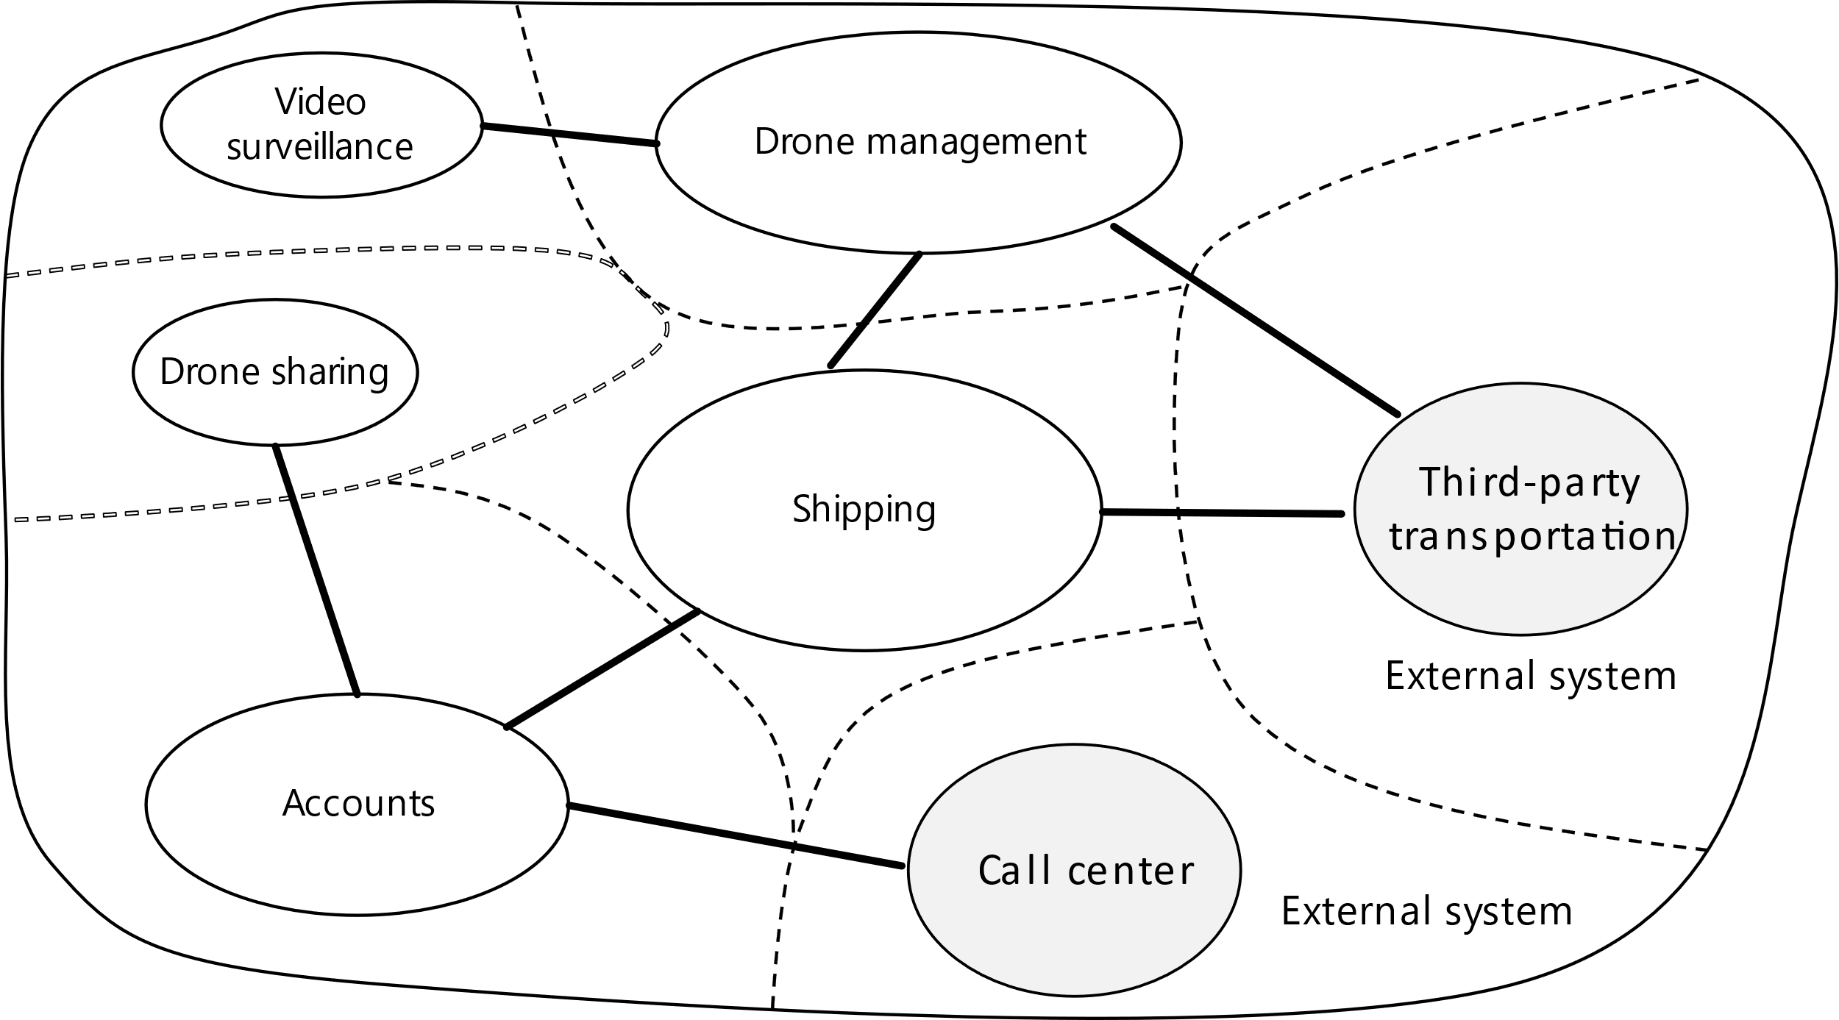
Slicing the Monolith: Service boundaries
Analyze domain
Define bounded contexts
Define entities, aggregates & services
Identity microservices
“
A bounded context is simply the boundary within a domain where a particular domain model applies.
”
[Domain-driven Design by Eric Evans]
Notes:
SPEAKER NOTES:
As stated previously, microservices follow a rather holistic approach so they can evolve individually, basically by aligning business, services and team boundaries.
But how to identify the business boundaries? How can you derive the service boundaries from them? This is where the well established Domain-driven Design or short DDD by Eric Evans comes into play.
With DDD you first identify sub domain within your business domains, the so called bounded context. Take an e-commerce application for instance: Ordering, shipping, catalogue, etc.
Usually you talk to different domain experts, each one using their own language. This deferent domain experts and their languages or so called ubiquitous language are good indicators for bounded contexts.
A microservice itself should not span more than one bounded context, since bounded contexts should evolve independently.
If the bounded context is still to big, take a look into other DDD concepts like aggregates and domain services as well.
You can find more detailed information about them in the links provided at the end. We will not go into detail here since you can fill easily a whole presentation about DDD.
There are also alternatives to using DDD. Event-storming invented by Alberto Brandolini is also a quiet common technique to better understand your business boundaries.
Finally encapsulating non-functional requirements like authentication in a separate microservice makes a lot of sense as well.

Slide 10
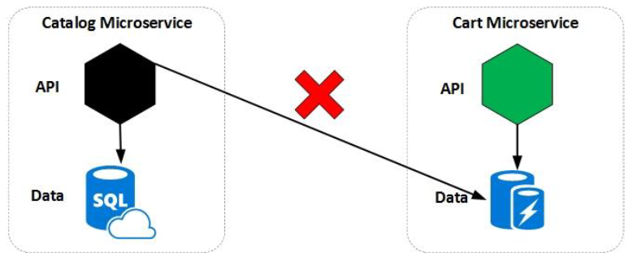
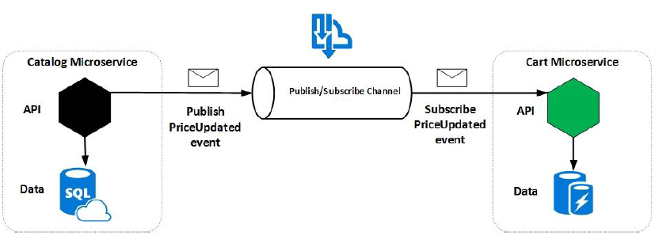
Dicing the Monolith: Data considerations
Every service manages its own data
No sharing of data stores between services
Service might represent the source of truth for a given entity («master»)
Other services might hold a subset of the entity
Embrace eventual consistency (no distributed transactions)
Profit from polyglot persistence / materialized view
Notes:
SPEAKER NOTES:
Data is one of the most trickiest part when embracing a microservice-based architecture.
Every microservice manages its own data store, so there is no sharing of data stores between services.
Some services might represent the source of truth for a given entity (“master”), while others might hold a subset of the entity.
Takes for instance an e-commerce application. Probably there will be some user management microservice connected to a CRM system.
Other microservices might also require part of the user data, i.e. the users name and shipping address are required in the shipping microservice.
As stated previously, microservices should use asynchronous communication to talk to each other.
So you could easily publish changes from the user management service (“master”) and subscribe from the shipping microservice.
Basically embracing eventual consistency, which scales quiet well within distributed systems.
Also you might embrace polyglot persistence using different data stores for different purposes, i.e. graphs, documents, etc.
Applicable data-centric patterns (Use as segue into design patterns slide)
Materialized view: To support efficient querying, a common solution is to generate, in advance, a view that materializes the data in a format suited to the required results set. The Materialized View pattern describes generating prepopulated views of data in environments where the source data isn't in a suitable format for querying, where generating a suitable query is difficult, or where query performance is poor due to the nature of the data or the data store.
Command and Query Responsibility Segregation (CQRS): Command and Query Responsibility Segregation (CQRS) is a pattern that segregates the operations that read data (queries) from the operations that update data (commands) by using separate interfaces. This means that the data models used for querying and updates are different (at the API/service level for CQRS, at the class level for CQS).
Event Sourcing: Instead of storing just the current state of the data in a domain, use an append-only store to record the full series of actions taken on that data. The store acts as the system of record and can be used to materialize the domain objects. This can simplify tasks in complex domains, by avoiding the need to synchronize the data model and the business domain, while improving performance, scalability, and responsiveness. It can also provide consistency for transactional data, and maintain full audit trails and history that can enable compensating actions.
Often used to generate/build materialized views.

Slide 11
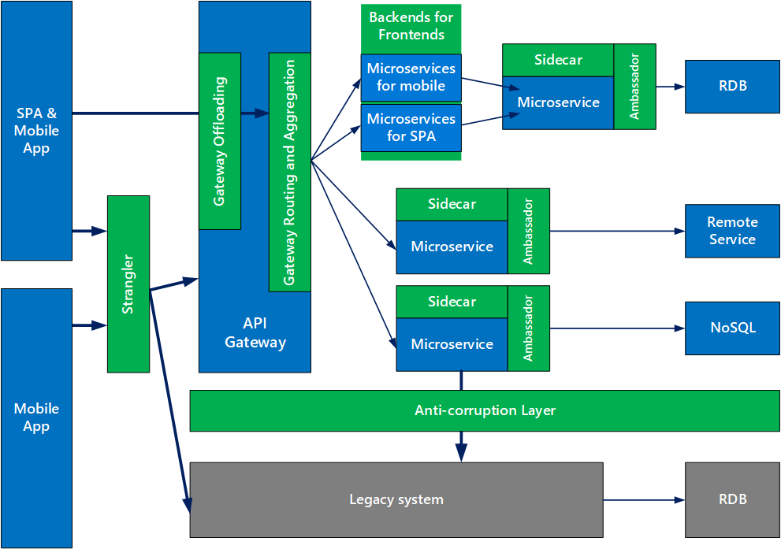
Design Patterns for Microservices
API Gateway
Ambassador
Sidecar
Strangler
Anti-corruption layer
Bulkhead
Gateway Offloading
Circuit Breaker
Cache-Aside
Notes:
Refactoring
Ease of use
Resiliency
SPEAKER NOTES:
There are numerous design patterns that are applicable to microservices, don’t have time to cover them all. These are just a few of the key patterns.
Refactoring patterns
Strangler: Use strangler, instead of big cut-over, to mitigate risks. When moving from a monolith, build the system around the edges of the old, growing it slowly until it takes over the old, much like a strangler vine slowly killing off a tree that it climbs on.
Ease of use patterns
API Gateway: Place a gateway in front of a set of applications, services, or deployments. Use application Layer 7 routing to route the request to the appropriate instances.
With this pattern, the client application only needs to know about and communicate with a single endpoint. If a service is consolidated or decomposed, the client does not necessarily require updating. It can continue making requests to the gateway, and only the routing changes.
Resiliency/performance patterns
Bulkhead: Use the bulkhead pattern to seal off sections of your application in order to isolate them and prevent cascading errors.
Circuit breaker: Handle faults that might take a variable amount of time to recover from, when connecting to a remote service or resource.

Slide 12
Orchestration vs Choreography
Send
Subscribe
Publish
Event
Orchestration
Choreography
Less coupling
More transparency
Notes:
Talk about the transport layer for each. They should be language agnostic
Synchronous: http, rpc
Async: http with callbacks, amqp
SPEAKER NOTES:
Let’s talk about workflows. Workflows typically span multiple microservices, but also include a certain state to indicate its progress.
You might use a dedicated workflow engine and perform orchestration, similar to the director of an orchestra.
While this provides you great transparency about the progress, it also comes with a certain coupling.
If less coupling is more desirable use choreography, which implicitly creates a workflow using an event-driven approach.

Slide 13

Interservice communication
Synchronous Communication
Synchronous communication. In this pattern, a service calls an API that another service exposes, using a protocol such as HTTP or gRPC. This option is a synchronous messaging pattern because the caller waits for a response from the receiver. Typically RESTful APIs are external-facing or exposed towards the UI. Callers must implement retry and timeouts for resiliency. APIs must be semantically versioned.
UI
Synchronous
Asynchronous Communication
Queue
Asynchronous message passing. In this pattern, a service sends messages without waiting for a response, and one or more services process the message asynchronously. Typically inter-service communication is implemented via asynchronous messaging using AMQP or similar protocols. Resilience is built into the underlying service bus, which follows the paradigm “smart endpoints and dumb pipes”. Messages must be semantically versioned.
Asynchronous
Notes:
SPEAKER NOTES:
Lets make an analogy when comparing synchronous to asynchronous communication.
Synchronous communication is like paying with your credit card. You insert your card, input your PIN and wait for the transaction to be approved.
In contrast, Asynchronous communication is non-blocking. It is more like ordering a pizza. You order it online and at some point in time you get it delivered.
While you could let microservices interact with each other using only synchronous HTTP-based REST APIs, this might not be desirable.
For instance think of downstream calls: Microservice A calls Microservice B, which then calls Microservice C and fails.
How can you rollback and compensate this business transactions? Also think about availability and scalability.
With synchronous communication the sender always waits for a response. If the receiver is temporarily not available you have a problem.
Also you basically block a thread on the sender and the receiver side, which obviously has some hardware based limitations.
Reliability, scalability and error handling using dead-letter queues is where asynchronous communication typically shines.
Following leverage synchronous communication on the UI side of things where waiting is desired. Between the microservices use asynchronous communication.
If that does not work for you, you might want to reconsider your business and service boundaries.

Slide 14








What is DevOps?
DevOps is the union of people, process, and tools to enable continuous delivery of value to our customers.
Create
Release
Plan
Configure
DEV
OPS
Package
Monitor
Verify
Increase flow of value
Shorten cycle times
Continuously Improve
Notes:
SPEAKER NOTES:
DevOps is a critical aspect to Microservices and one of the tenets of a 12-factor app
With smaller services, more moving parts, more to manage, it cannot be practically done without automation
The adoption of DevOps is cultural and most be adopted throughout an organization

Slide 16

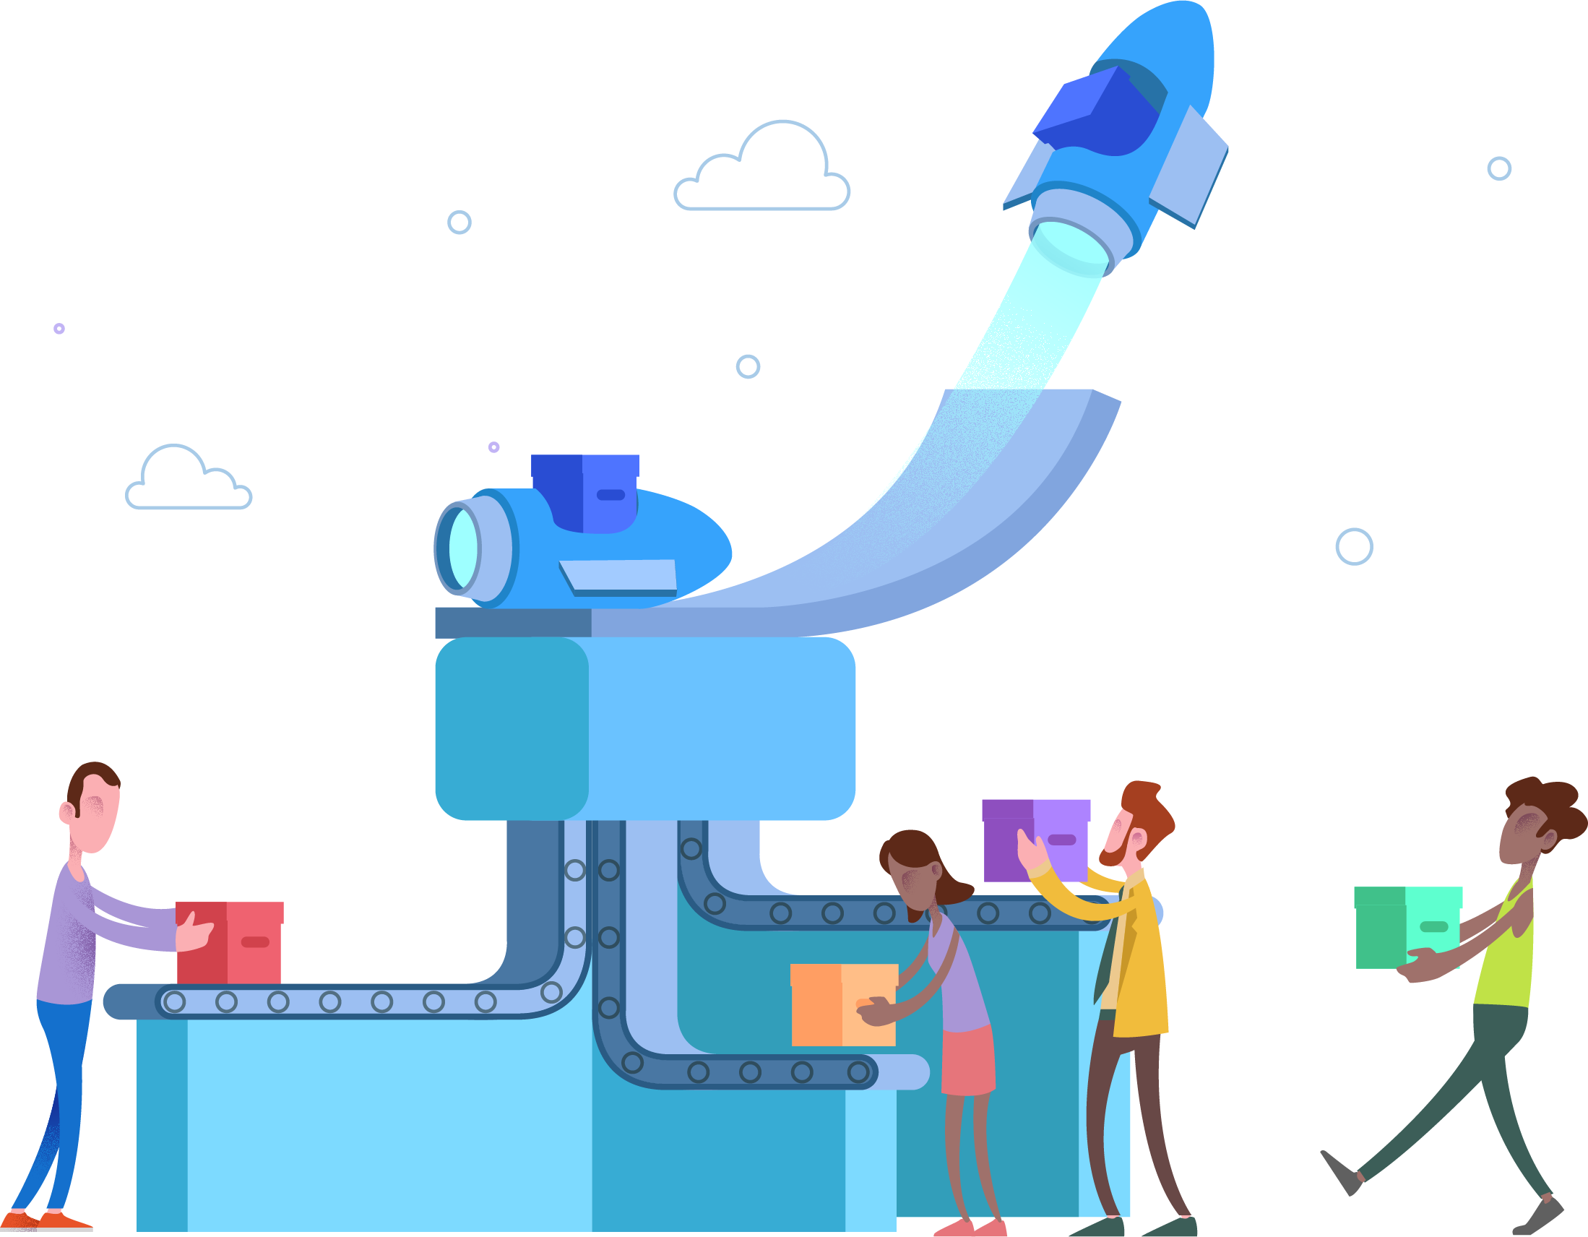
Microservices
Microservices architecture style
Designing, building, and operating microservices
Design patterns for microservices
Microservice Guide
Microservices
Notes:
SPEAKER NOTES:
Links to various microservices-related resources

Slide 17
Evolution of Application Architecture
N-Tier Architecture
Service-Oriented Architecture
Software-as-a-Service
The 12 Factor App

Slide 18
Software as a Service (SaaS)
“”A software distribution model in which a service provider hosts applications for customers and makes them available to these customers via the internet.” [www.infoworld.com]
Suitable for deployment on modern cloud platforms, obviating the need for servers and systems administration
Minimize divergence between development and production, enabling continuous deployment for maximum agility
Can scale up without significant changes to tooling, architecture, or development practices.
Notes:
SPEAKER NOTES:
The SaaS model original gave rise from app service providers, who crashed and burned at the time of the dotcom boom. The latter incarnation of SaaS is what is depicted on this slide. The more recent SaaS offerings often being hosted in the cloud.
SaaS is defined as … read the quote.
SaaS apps are:
Are suitable for deployment on modern cloud platforms
Minimize divergence between development and production, enabling continuous deployment for maximum agility
Can scale without significant changes to tooling, architecture, or development practices

Slide 19
The 12 Factors
I. Codebase
One codebase tracked in revision control, many deploys
II. Dependencies
Explicitly declare and isolate dependencies
III. Config
Store config in the environment
IV. Backing services
Treat backing services as attached resources
V. Build, release, run
Strictly separate build and run stages
VI. Processes
Execute the app as one or more stateless processes
VII. Port binding
Export services via port binding
VIII. Concurrency
Scale out via the process model
IX. Disposability
Maximize robustness with fast startup and graceful shutdown
X. Dev/prod parity
Keep development, staging, and production as similar as possible
XI. Logs
Treat logs as event streams
XII. Admin processes
Run admin/management tasks as one-off processes
[12factor.net]
Notes:
SPEAKER NOTES:
Codebase - Maintain a single codebase. Have multiple environments, multiple versions but all tying back to a common codebase.
Dependencies – goal is to simply check out code from source control and run a build. Keep dependency configuration explicit and external to the codebase.
Config – Keep configuration in the environments. Similar to Dependencies, goal is to check out and run build.
Backing services – your services will be interchangeable if you treat them as resources. Nothing more than a URL and credentials.
Build, release, run – keep these separate for ease of automation.
Processes – stateless processes are easy to scale, just deploy more of them.
Port binding – if your service must be visible, expose it via port binding so that it can be treated as a resource.
Concurrency – this is all about scale. Scale out by process, as opposed to scaling up (ex. By VM size).
Disposability – this is for agility, make things easy to spin up, scale up/down.
Dev/prod parity – in monolithic world, features are deployed to dev/test and may sit there for long periods of time waiting to be released to prod. This can be troublesome as you end up with significant differences across environments. Keep non-prod no more than a release out of sync with prod.
Logs – logs help ensure quality of service. Old school/monolithic, logs are often written to files; will not work very well in a distributed environment.
Admin processes - Concern here is isolation of dependencies; treat your admin processes as another service within the system.
Many of these factors will be evident in the remaining content.

Slide 20
What is a design pattern?
Reusable solutions to commonly occurring problems within a given context.
Formalized best practice that can be used to solve common problems.
“Each pattern describes a problem which occurs over and over again in our environment and then describes the core of the solution to that problem, in such a way that you can use this solution a million times over, without ever doing it in the same way twice”
Christopher Alexander, A Pattern Language, 1977
Notes:
SPEAKER NOTES:

Slide 21
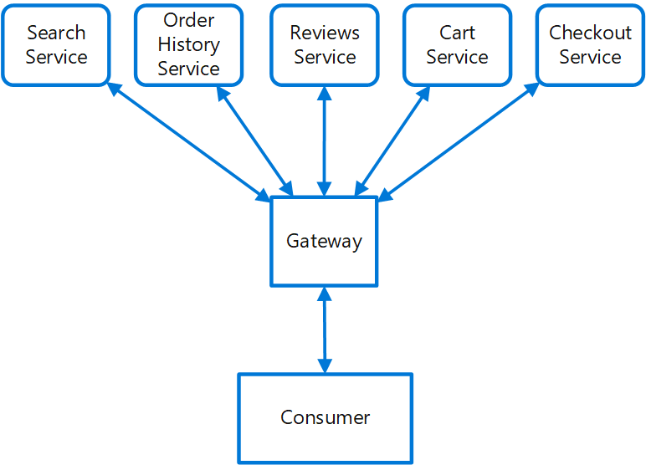
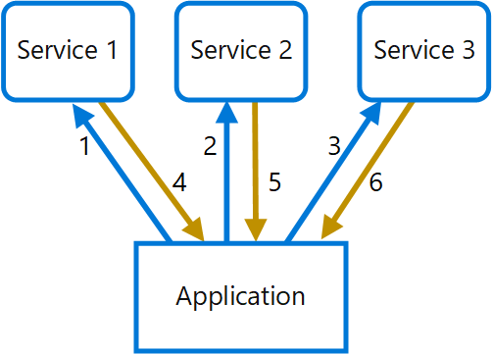
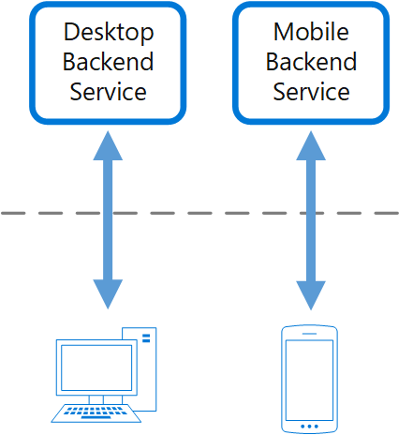
API Gateway
Problem How do clients of microservices-based applications access the individual services?
Solution Use an API gateway to define routes and endpoints in configuration where each route is associated to an endpoint to handle that route.
API Gateway/Gateway Routing
Place a gateway in front of a set of applications, services, or deployments.
Client application only needs to know about and communicate with a single endpoint.
Gateway Aggregation
Use a gateway to reduce chattiness between the client and the services.
Gateway receives client requests, dispatches requests to the various backend systems, and then aggregates the results and sends them back to the requesting client.
Backend for Front-end
Create one backend per user interface. Fine tune behavior and performance of each backend to best match the needs of frontend environment, without worrying about affecting other frontend experiences.
Notes:
SPEAKER NOTES:
Variations – gateway routing, gateway aggregation, backend for frontend,

Slide 22
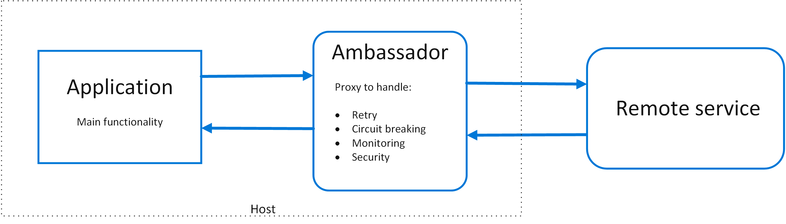
Ambassador
Problem
How do you retrofit legacy apps with fundamental cloud native capabilities to be resilient, fault tolerant (retry logic, circuit breaker, bulkhead)?
Solution
Put client frameworks and libraries into an external process that acts as a proxy between your application and external services.
Deploy the proxy on the same host environment as your application to allow control over routing, resiliency, security features, and to avoid any host-related access restrictions.
Features that are offloaded to the ambassador can be managed independently of the application. You can update and modify the ambassador without disturbing the application's legacy functionality.

Slide 23
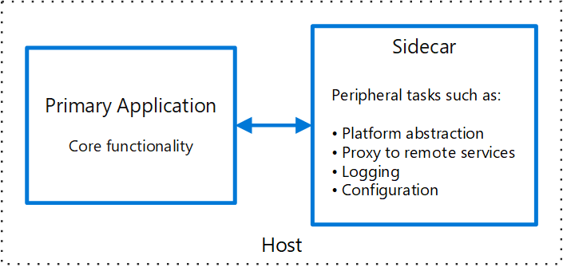
Sidecar
Problem
Applications and services often require related functionality, such as monitoring, logging, configuration, and networking services. How can one implement such functionality in a loosely coupled, isolated fashion?
Solution
Co-locate a cohesive set of tasks with the primary application, but place them inside their own process or container, providing a homogeneous interface for platform services across languages.
Sidecar characteristics
Is independent from its primary app in terms of runtime environment and programming language
Can access the same resources as the primary app.
No significant communication latency to primary app.
often used with containers and referred to as a sidecar container or sidekick container.

Slide 24
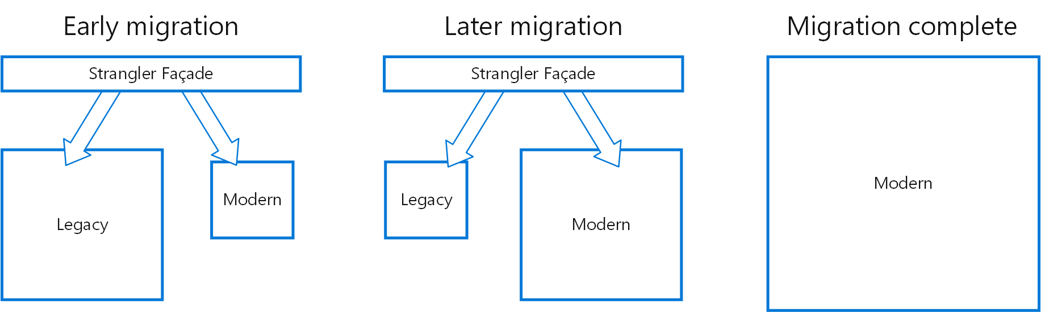
Strangler
Problem How do I incrementally modernize and migrate a legacy system to new methods and methodologies while mitigating the risk of a big cut-over?
Solution Incrementally replace specific pieces of functionality with new applications and services. Create a façade that intercepts requests going to the backend legacy system. The façade routes these requests either to the legacy application or the new services. Existing features can be migrated to the new system gradually, and consumers can continue using the same interface, unaware that any migration has taken place.
Notes:
SPEAKER NOTES:
Use strangler, instead of big cut-over, to mitigate risks
When moving from a monolith, build the system around the edges of the old, growing it slowly until it takes over the old, much like a strangler vine slowly killing off a tree that it climbs on

Slide 25
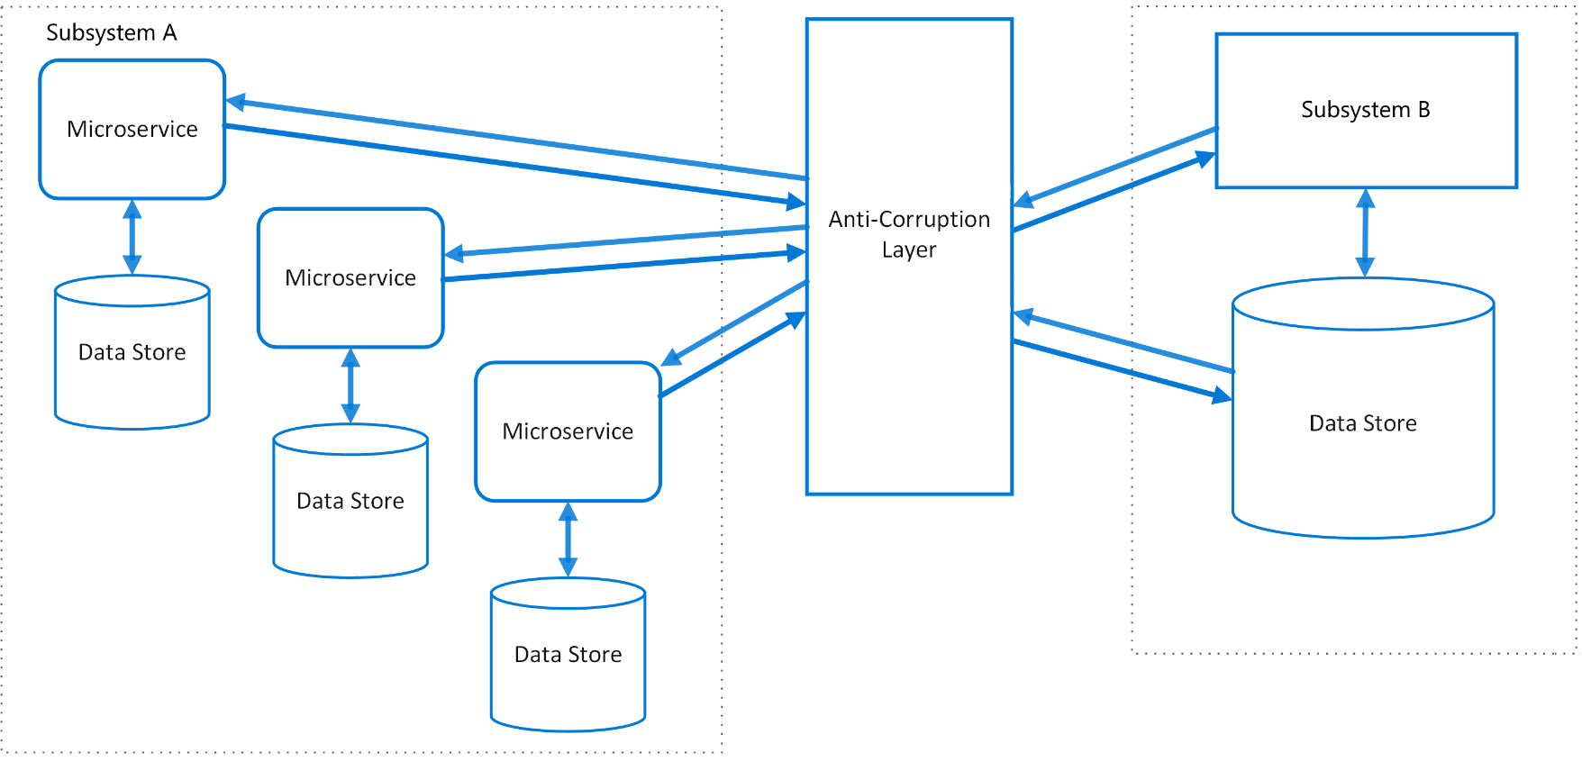
Anti-Corruption Layer
Problem Applications rely on other systems for some data or functionality. When a legacy appl is modernized, it may still need existing legacy resources. New features must be able to call the legacy system.
Legacy systems often suffer from quality issues due to convoluted data schemas or obsolete APIs. Features and technologies used in legacy systems can vary widely from more modern systems. For interop, new app may need to support outdated infrastructure, protocols, data models, APIs, or other features that you wouldn't otherwise put into a modern application.
Similar issues can arise with any external system.
Solution Isolate the different subsystems by placing an anti-corruption layer between them. This layer translates communications between the two systems, allowing one system to remain unchanged while the other can avoid compromising its design and technological approach.
Notes:
SPEAKER NOTES:
The diagram above shows an application with two subsystems. Subsystem A calls to subsystem B through an anti-corruption layer. Communication between subsystem A and the anti-corruption layer always uses the data model and architecture of subsystem A. Calls from the anti-corruption layer to subsystem B conform to that subsystem's data model or methods. The anti-corruption layer contains all of the logic necessary to translate between the two systems. The layer can be implemented as a component within the application or as an independent service.
Pattern originated from DDD as a means of linking two bounded contexts.
Use
When refactoring legacy into new – prevents shinny new system from being “corrupted”/polluted by legacy semantics
To isolate your system from 3rd party dependencies; when 3rd party changes, your code changes are limited to this layer
Considerations
Introduces additional latency
May not be necessary/suitable if 2 subsystems have limited semantic differences

Slide 26
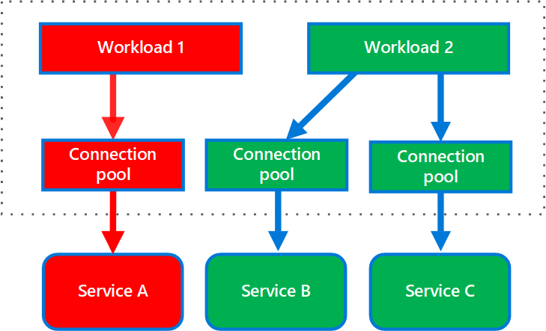
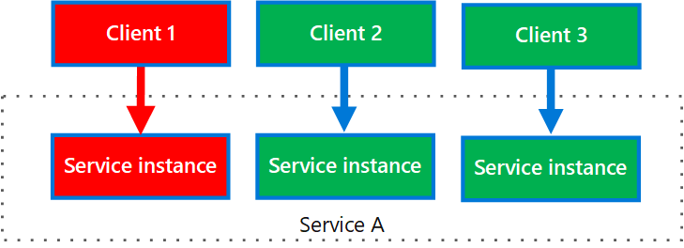
Bulkhead
Problem How can you seal off sections of your application in order to isolate them and prevent cascading errors?
Solution Partition service instances into different groups, based on consumer load and availability requirements. This design helps to isolate failures, and allows you to sustain service functionality for some consumers, even during a failure.
A consumer can also partition resources, to ensure that resources used to call one service don't affect the resources used to call another service. For example, a consumer that calls multiple services may be assigned a connection pool for each service. If a service begins to fail, it only affects the connection pool assigned for that service, allowing the consumer to continue using the other services.
Example Single service implemented in a containerized environment as a discrete container with defined resource requests and limits for CPU and memory.

Slide 27
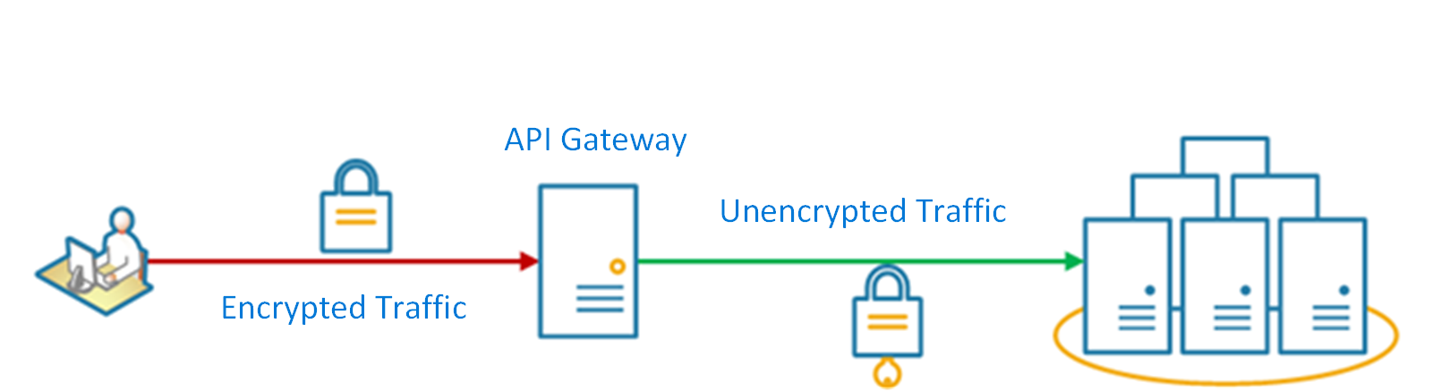
Gateway Offloading
Problem Features such as token validation, HTTPS certificate, encryption, authZ, authN. These features require development, configuration management, and maintenance. Deploying such features with each service increases the maintenance overhead.
Solution Offload some features into an API gateway, particularly cross-cutting concerns such as certificate management, authentication, SSL termination, monitoring, protocol translation, or throttling.
Considerations Features such as token validation, HTTPS certificate, encryption, authZ, authN. These features require development, configuration management, and maintenance. Deploying such features with each service increases the maintenance overhead.
Examples
Use NGINX or Traefik for SSL offloading
Use Azure API Management for SSL offloading, authZ, caching, throttling, etc.

Slide 28
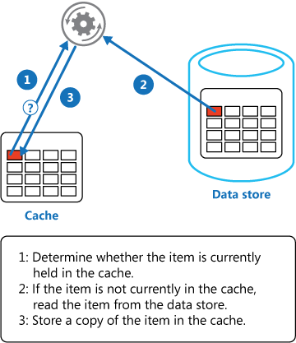
Cache-Aside
Problem Applications use a cache to improve repeated access to information held in a data store. However, it's impractical to expect that cached data will always be completely consistent with the data in the data store. Applications should implement a strategy that helps to ensure that the data in the cache is as up-to-date as possible, but can also detect and handle situations that arise when the data in the cache has become stale.
Solution Use a cache-aside strategy to emulate commercial caching systems that provide read-through and write-through/write-behind operations. Load data into the cache data on-demand.
If an application updates information, it can follow the write-through strategy by making the modification to the data store, and by invalidating the corresponding item in the cache.
When the item is next required, using the cache-aside strategy will cause the updated data to be retrieved from the data store and added back into the cache.

Slide 29
Team boundaries
Organizations which design systems are constrained to produce designs which are copies of the communication structures of these organizations.
“
”
- Melvin E. Conway
Fine-grained communication required for developing a single microservice, following choose small co-located team who owns a microservice („2 pizza team“)
Coarse-grained communication required between loosely coupled teams in order to scale, following no requirement for co-location but for stable and versioned APIs
Align domain, service and team boundaries
Notes:
SPEAKER NOTES:
So we aligned the service boundaries to the business boundaries, but what about the team structure.
Melvin E. Conway formulated a law named after him to outline the implications of organizations and their communication structure on the product designs they produce.
Co-located teams tend to couple their product more, since they can communicate frequently and often. Split teams try to agree on stable APIs, since they cannot communicate in a so fine-grained fashion.
This principle can be leveraged when developing microservices. While you want coarse-grained communication via stable APIs between microservices,
you want fine-grained communication within your microservices since you interact on code-level.
Following let a co-located team own a microservice and only them, with other teams located anywhere only use stable and versioned APIs to use this microservice.
As a result, we aligned domain, service and team boundaries, which is quiet powerful to evolve these microservices and their bounded context individually.

Slide 30

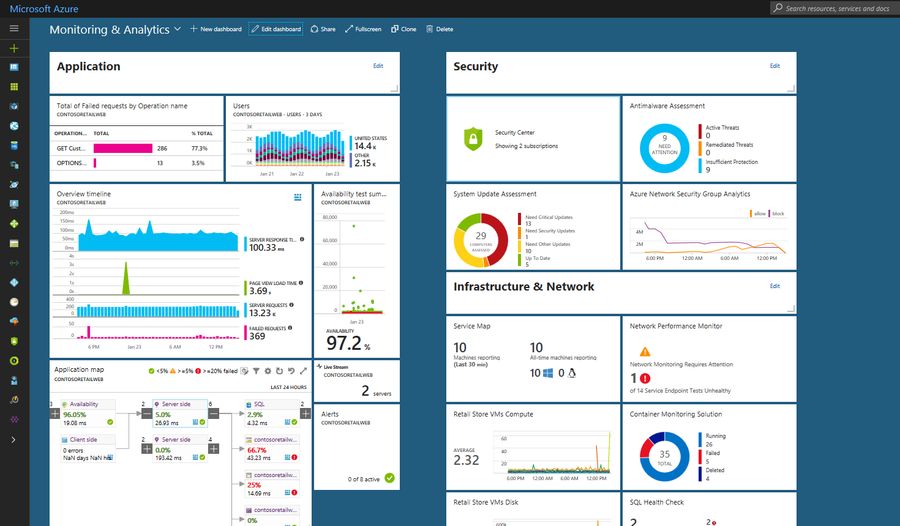
Continuous learning & monitoring
+ CorrelationId
Microservice
Logging
System
Notes:
SPEAKER NOTES:
Business processes usually span multiple microservices. Since each microservice individually performs logging, a logging system is required to aggregate them.
Use a CorrelationId known by all microservices to identify the instance of your business process. This helps you especially during error tracking and mitigation.
Also the application monitoring should allow you drill-down from system level to each microservices to identify the root cause of an error quickly.
Azure for instance provides you with Azure Monitor and the screenshot of the dashboard is actually the one provided by Service Fabric.

Slide 31
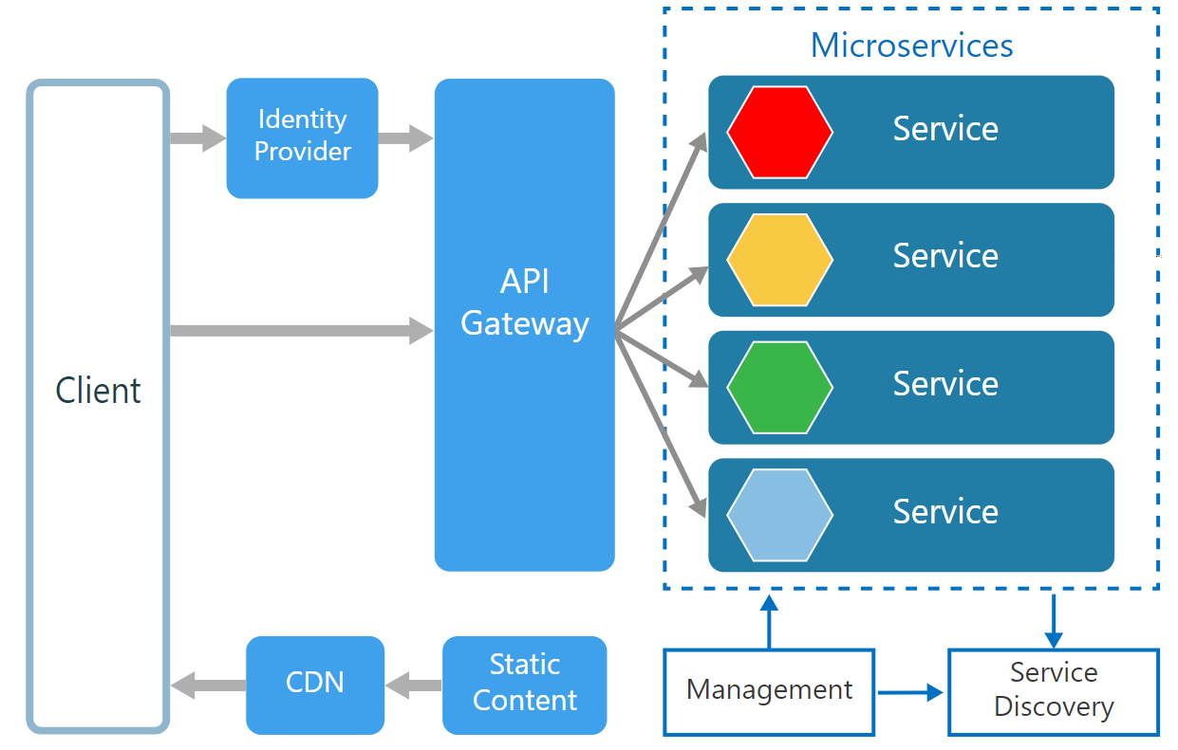
Microservices Consider for:
Apps with many subdomains
Scaling towards multiple teams
Require high release velocity
Require granular scalability
Notes:
SPEAKER NOTES:
As we have seen, microservices are no silver bullet. They come with a lot of operational complexity, but sticking to best practices and embracing Microsoft Azure can help you greatly adopting them.
In general microservices follow a rather holistic approach so they can evolve individually, basically by aligning business, services and team boundaries.
Following they are great for apps with many subdomains, when scaling towards multiple teams or if you require a higher release velocity or a more granular scalability.

